Slide 1

Problem of Symmetric Cryptography Algorithm
Henric Johnson

Slide 2
Key Distribution
Symmetric schemes require both parties to share a common/same secret key.
Issue is how to securely distribute this key.
So some mechanism is required for secure transmission of key is known as key distribution.
often secure system fails due to a break in the key distribution scheme.
Notes:
This is one of the most critical areas in security systems - on many occasions systems have been broken, not because of a poor encryption algorithm, but because of poor key selection or management. It is absolutely critical to get this right!

Slide 3
Key Management
Authentication of the users of the key.
Generation of key.
Distribution of key.
Storage of key.

Slide 4
Key Distribution
Given parties A and B have various key distribution alternatives:
  A can select key and physically deliver to B.
  Third party can select & deliver key to A & B.
  If A & B have communicated previously can use previous key to encrypt a new key
  If A & B have secure communications with a third party C, C can relay key between A & B
Notes:
Physical delivery (1 & 2) is simplest - but only applicable when there is personal contact between recipient and key issuer. Is fine for link encryption where devices & keys occur in pairs, but does not scale as number of parties who wish to communicate grows.
A third party is a trusted intermediary, whom all parties trust, to mediate the establishment of secure communications between them. Must trust intermediary not to abuse the knowledge of all session keys.
As number of parties grow, some variant of 4 is only practical solution.

Slide 5
Key Distribution
Session key:
  Data encrypted with a one-time session key. At the conclusion of the session the key is destroyed.
Permanent key:
  Used between entities for the purpose of distributing session keys.
Henric Johnson

Slide 6
Automatic Key Distribution
Session Key
  Used for duration of one logical connection
  Destroyed at end of session
  Used for user data
Permanent key
  Used for distribution of keys
Key distribution center
  Determines which systems may communicate
  Provides one session key for that connection
Front end processor
  Performs end to end encryption
  Obtains keys for host

Slide 7
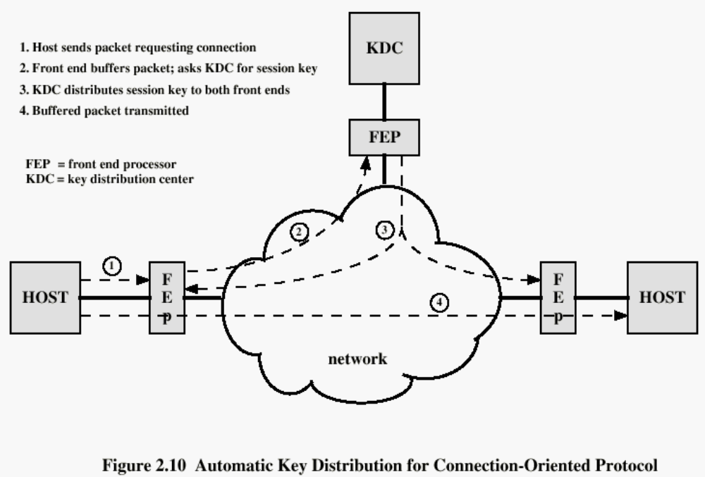
Henric Johnson

Slide 8
Key Distribution in Public key Crypto
Following are the 4 ways
Public Announcement
Publicly available directory
Public key Authority
Public key Certificate
Henric Johnson

Slide 9
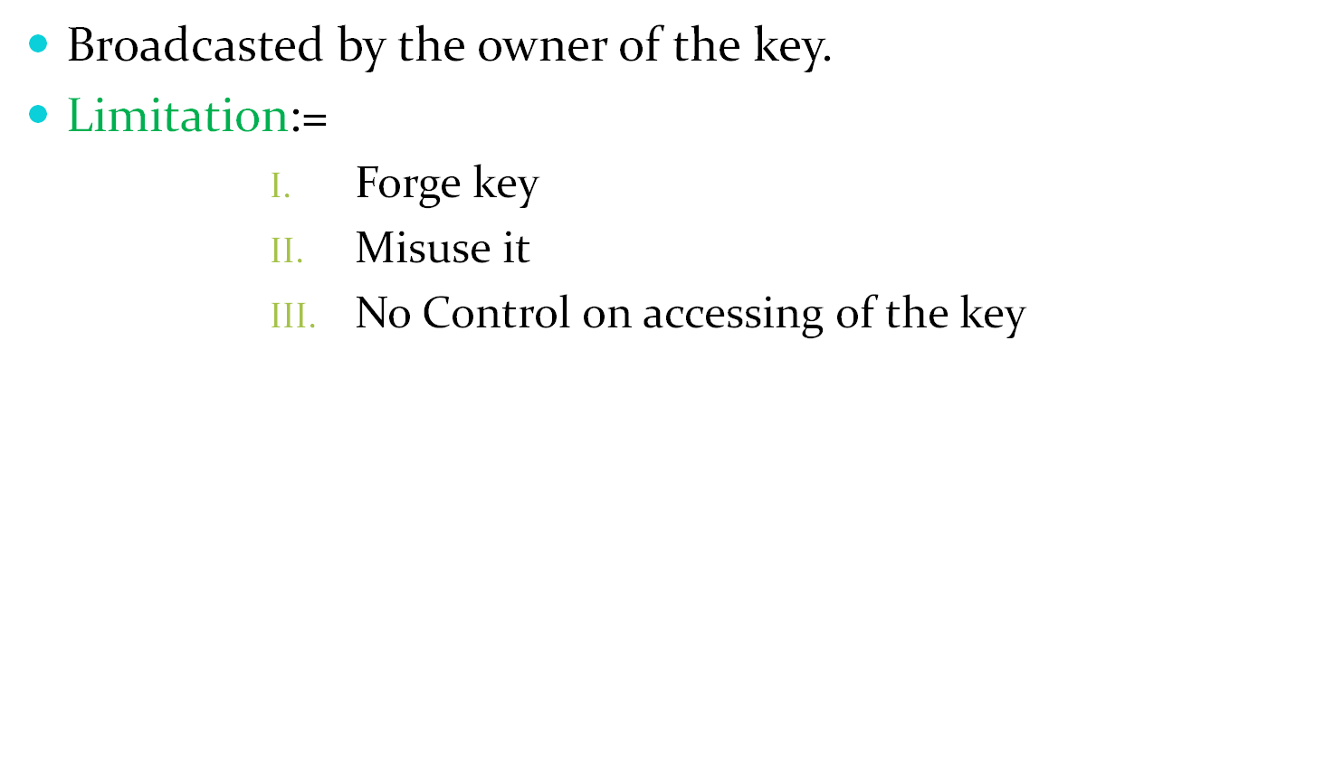
1. Public Announcement
Henric Johnson

Slide 10
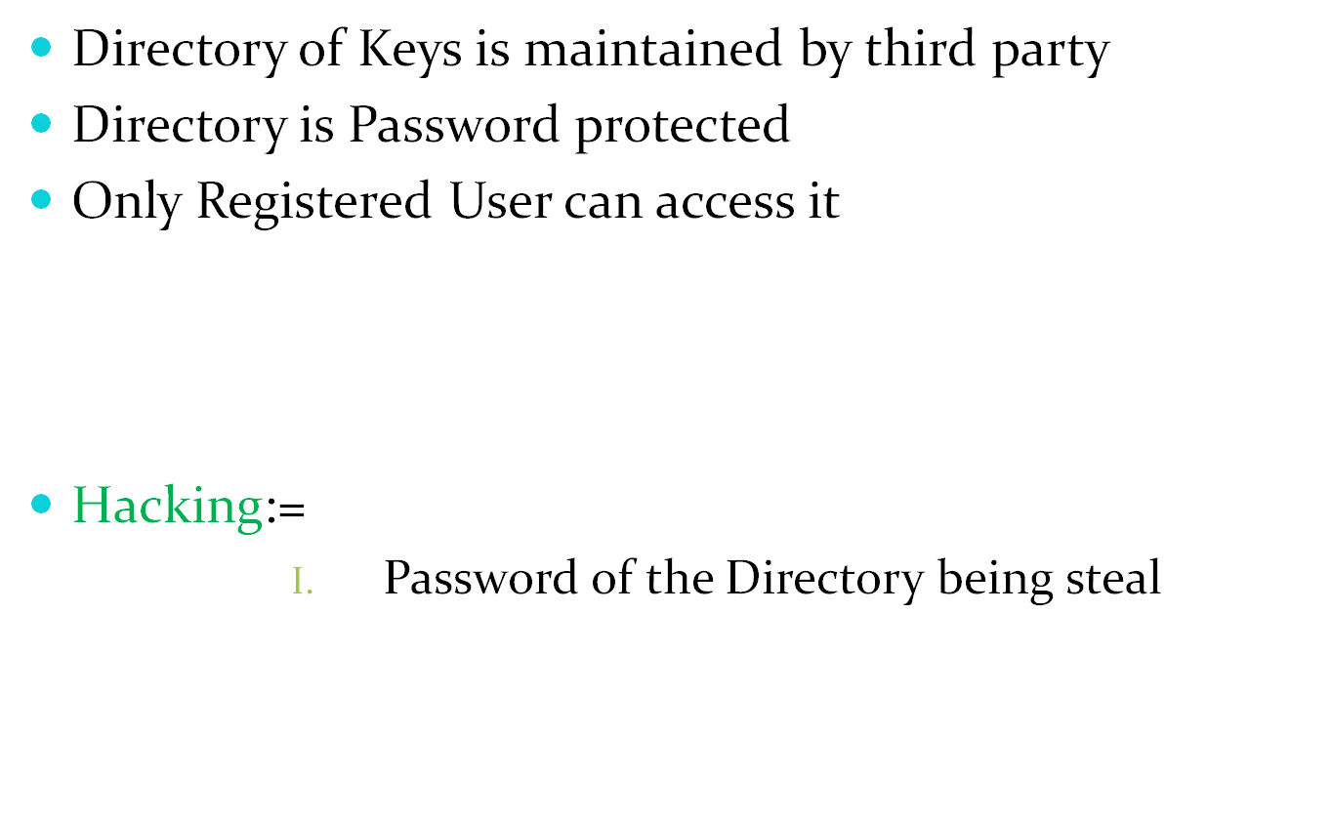
2. Publicly Available Directory
Name | Public Key
A | 115
B | 215
Henric Johnson

Slide 11
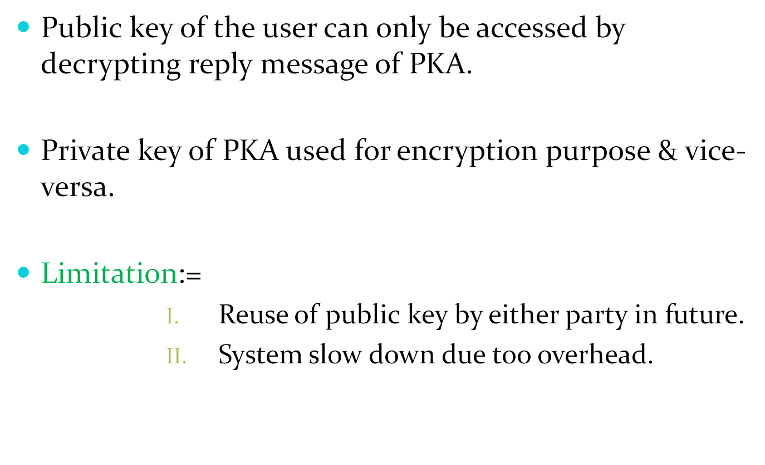
3. Public Key Authority(PKA)
Henric Johnson

Slide 12
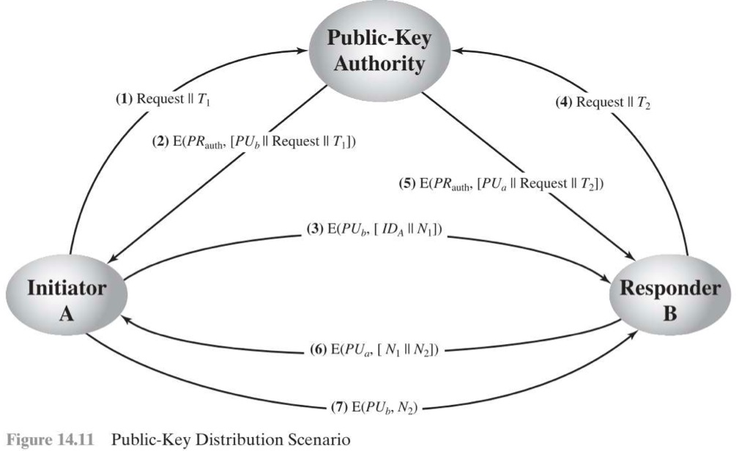
T1 & T2 – time of request
N1 & N2 – random number called as nounce.
IDA – network address of Initiator A for communication
Step 7- Initiator A confirm the Request by replying back.
Henric Johnson

Slide 13
3. Public Key Certificate(PKC)
Suggested by Kohnfelder.
Initiator sends name & his public key.
Public keys are exchanged by means of certificates.
Private key of PKC used for encryption purpose & vice-versa.
Certificate contains information such as time of the request, network address & public key of the user who made the request.
Henric Johnson

Slide 14
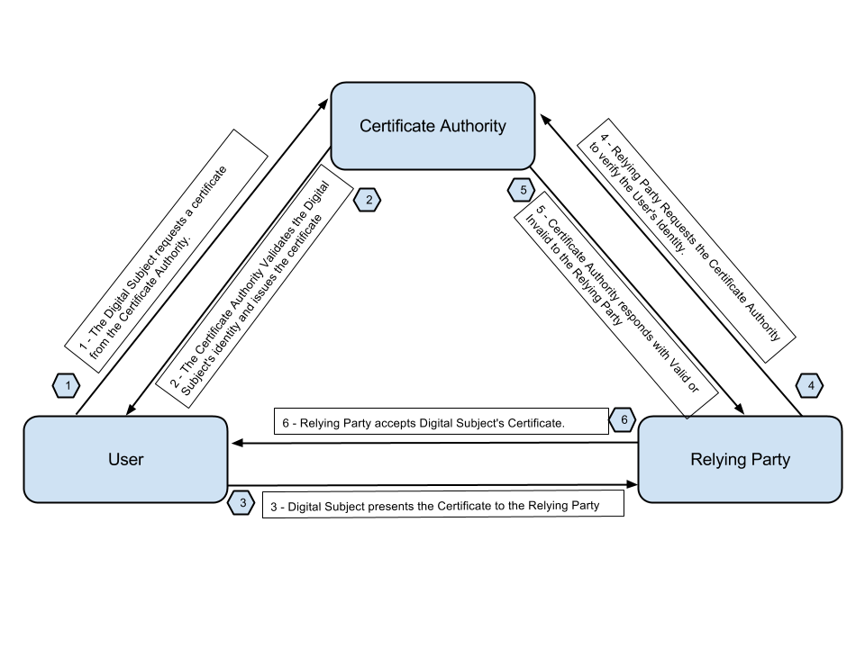
PKC Overview

Slide 15
Key Distribution Issues
Hierarchies of KDC’s required for large networks, but must trust each other
Session key lifetimes should be limited for greater security
Use of automatic key distribution on behalf of users, but must trust system
Use of decentralized key distribution
Controlling purposes keys are used for

Slide 16
Summary
have considered:
  use of symmetric encryption to protect confidentiality
  need for good key distribution
  use of trusted third party KDC’s

Slide 17
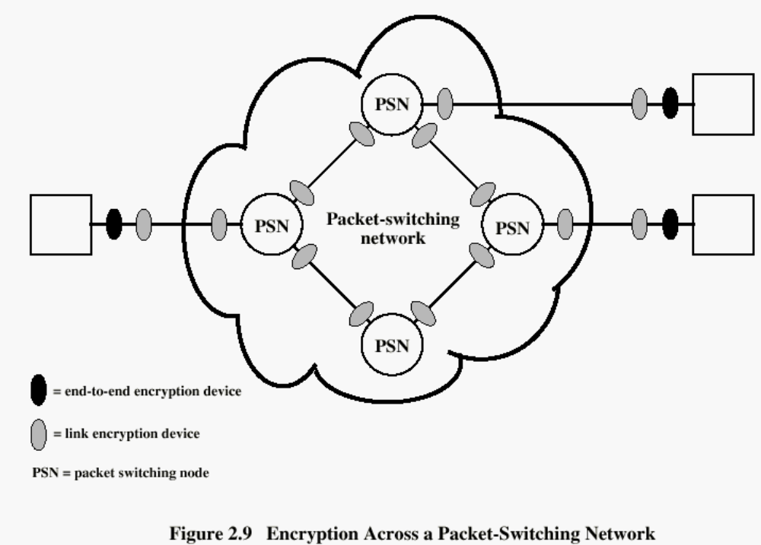
Henric Johnson

Slide 18
Recommended Reading
Stallings, W. Cryptography and Network Security: Principles and Practice, 2nd edition. Prentice Hall, 1999
Scneier, B. Applied Cryptography, New York: Wiley, 1996
Mel, H.X. Baker, D. Cryptography Decrypted. Addison Wesley, 2001
Henric Johnson

